Slide 1

Executive Summary
Hyperparameter Tuning takes long time to compute, due to the limit time on this study, and I skipped this step. It will overall improve the performance of models.
Compare the modeling approaches based on the model output, we can see logistic regression and other ML has similar performance. random forest has higher AUC. Gradient Boosting Machine (GBM) model "Area under curve (AUC) : 0.506" Logistic regression model "Area under curve (AUC) : 0.519" Random forest "Area under curve (AUC) : 0.532 "
Advantages of Logistic regression is easier to implement, interpret, and very efficient to train. It makes no assumptions about distributions of classes in feature space. It can interpret model coefficients as indicators of feature importance. One of Disadvantage is if the number of observations is lesser than the number of features, Logistic Regression should not be used, otherwise, it may lead to overfitting.
Advantages of Random Forest algorithm is less prone to overfitting than Decision Tree and other algorithms, Random Forest algorithm outputs the importance of features which is a very useful. Disadvantages of Random Forest algorithm: Random Forest algorithm may change considerably by a small change in the data. Random Forest algorithm computations may go far more complex compared to other algorithms.

Slide 2
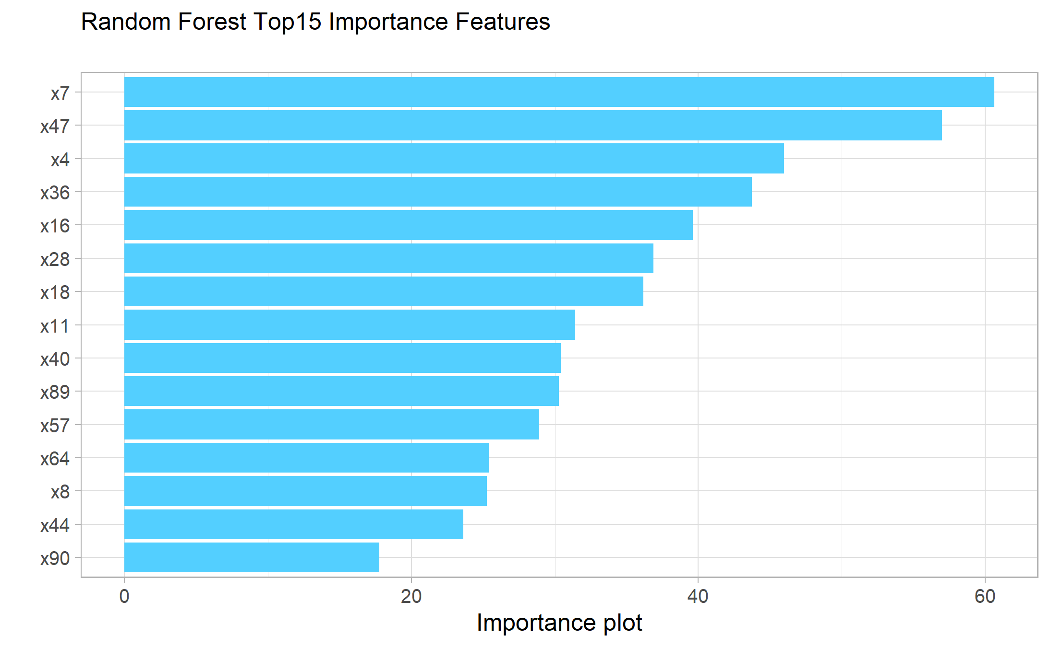
Executive Summary Communication with Stakeholder
Key point :
Make it as simple as possible, they don’t talk statistics language.
Our problem is non-linear, so Random Forest should be used.
Visualization is best way to communicate with stakeholder.

